Slide 1

AI-Driven Early Skin Health Intelligence and Risk-Aware Clinical Decision Support
Team Members:
1. Mesa Dhanushya - 2411021060545
  2. SallagundlaYaswanth - 2411021060495
  3. Ramasani Poojitha - 2411021060490
  4. Varij Nayan - 2411021060478
Name of the Mentor: Dr.T.Prasanth
E1CSA313/E1ITA306 Design Project -1

Slide 2

Agenda
• Introduction
• Literature Review
• Observations & Limitations
• Problem Statement & Scope
• Proposed Solution & Objectives
• Methodology
• Requirements
• Experimentation
• Results & Discussion
• Conclusion & Future Directions
• References

Slide 3

Introduction
• AI-based early skin-health screening
• Analyzes skin images and health data
• Identifies potential abnormalities early
• Provides risk-aware decision support
• Supports clinicians — does not replace them

Slide 4

Review of literature
S.No | Author Name, Journal, Publication Year | Research/ Methodology | Performance Metrics | Advantages | Disadvantages
1 | P. Papachristou et al., British Journal of Dermatology,2024 | AI smartphone app; dermoscopy; prospective multicentre clinical study | AUROC 0.960; Sensitivity 95.2% Specificity 84.5% | Real-patient study; Clinical decision support; early melanoma detection | Mainly melanoma-focused; limited confirmed melanoma cases
2 | A. Escalé-Besa et al., Healthcare,2024 | Systemic review; PRISMA; AI skin-disease diagnosis | Sensitivity 58-96.1%; Accuracy 0.41-0.93 | Covers multiple diseases; primary-care application | Heterogeneous Studies; limited representive datasets
3 | M. Groh et al., Nature Medicine, 2024 | Deep-learning decision support; multiple skin tones | >33% improvement with AI assistance; 364 images; 46 diseases | Doctor-AI collaboration; skin-tone analysis | Remaining skin-tone performance gap; simulated setting
4 | L. Heinlein et al., Communications Medicine, 2024 | ADAE ensemble CNN; dermoscopic images; 8 hospitals | Balanced accuracy 79.8%; Sensitivity 92.1%; Specificity 67.3% | Real-world data; diverse cameras and melanoma types | Lower specificity; performance varies by lesion
5 | Zhou et al., Nature Communications, 2024 | SkinGPT-4; vision transformer + Llama-2; multimodal AI | 52,929 images; evaluated on 150 real-life cases | Interactive diagnosis; combines image + language | Complex model; requires further clinical validation

Slide 5

Observations from the Literature Review
• AI supports early lesion identification
• Deep learning shows strong potential
• Clinical testing is important
• Performance depends on skin tone & image quality
• Research is moving toward risk-aware decision support

Slide 6

Limitations from the Literature Review
• Limited dataset diversity
• Focus on melanoma / selected diseases
• Image quality affects performance
• Limited real-world clinical validation
• AI cannot replace professional diagnosis

Slide 7

Problem Statement / Scope of the Project
Problem:
• Self-medication can delay proper treatment
• Limited access to dermatology in some areas
• Existing systems often focus only on classification
Scope:
• Analyze images + symptoms
• Classify selected conditions
• Estimate risk & confidence
• Track changes and provide guidance
• Recommend professional consultation

Slide 8

Proposed Idea / Solution
• Web-based AI skin-health platform
• Upload skin image + enter symptoms
• Detect possible conditions
• Generate confidence score & risk level
• Track changes over time
• Provide preventive guidance
• Recommend professional consultation

Slide 9

Objectives of the Idea / Solution as Design Project
• Detect selected skin conditions early
• Compare suitable AI/ML models
• Generate confidence & risk scores
• Provide preventive guidance
• Support timely professional consultation

Slide 10

Proposed Research / Methodology
1. Dataset preparation
2. Image preprocessing
3. AI/ML model development
4. Risk assessment & decision support
5. Preventive guidance & monitoring
6. System evaluation & validation

Slide 11

Hardware Requirements
• Processor: Intel i5 / Ryzen 5 or above
• RAM: 8 GB minimum
• Storage: 256 GB SSD minimum
• GPU: Optional; recommended for training
• Camera: 12 MP
• Internet: Required for web/cloud services

Slide 12

Software Requirements
• OS: Windows 10/11 or Linux
• Python 3.10+
• TensorFlow / Keras, Scikit-learn
• OpenCV, Pillow
• Flask
• HTML, CSS, JavaScript
• MySQL / SQLite

Slide 13

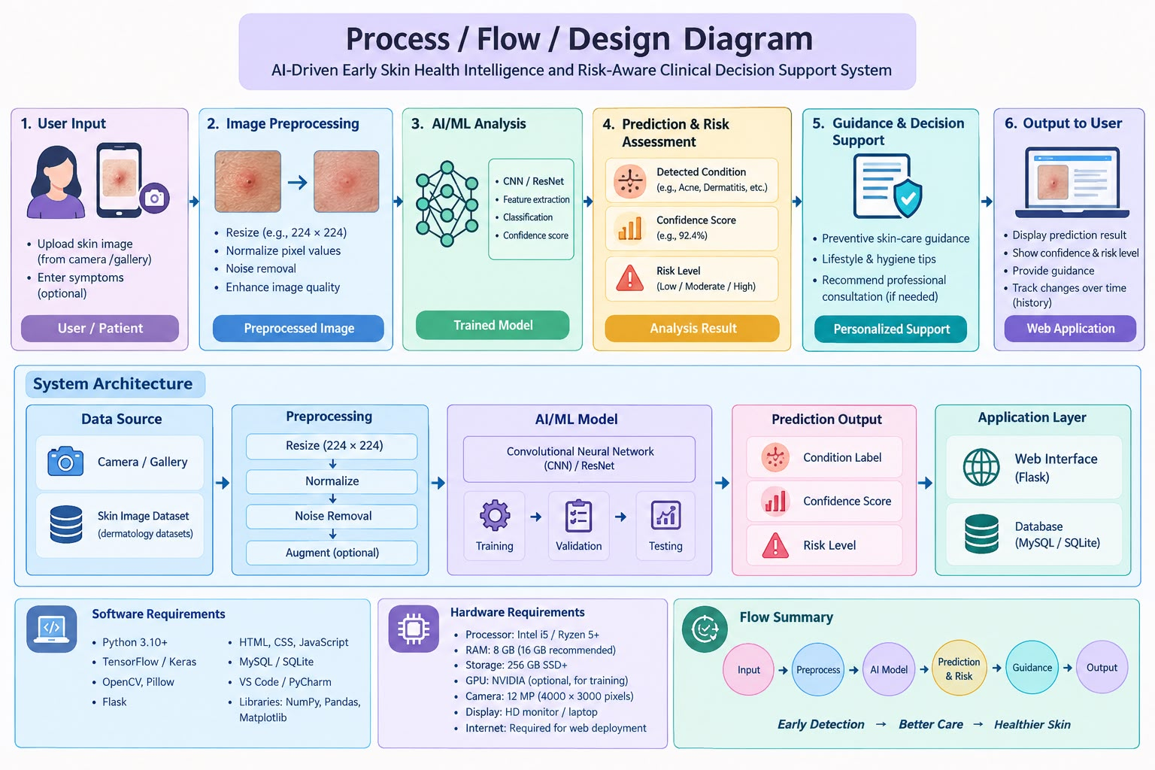
Process / Flow / Design Diagram
Image +
Symptoms
Preprocess
AI Analysis
Risk +
Confidence
Guidance /
Consultation
Simple end-to-end workflow for AI-assisted skin-health screening

Slide 14

Experimentation
• Collect selected skin-condition images
• Preprocess: resize, normalize, augment
• Train & compare CNN, ResNet, EfficientNet
• Test on unseen images
• Generate prediction, confidence & risk
• Evaluate Accuracy, Precision, Recall & F1-score
• Integrate model into Flask application

Slide 15
Results and Discussion
• AI can identify selected skin conditions
• Produces confidence score & risk level
• Preprocessing improves consistency
• Provides preventive guidance
• Recommends consultation for higher-risk cases
• Performance measured using standard metrics

Slide 16
Conclusion & Future Directions
Conclusion
• AI supports early skin-health assessment
• Provides prediction, confidence & risk level
• Offers preventive guidance
• Supports — not replaces — dermatologists
Future
• More diverse datasets
• More skin conditions
• Better multimodal AI
• Continuous monitoring
• Telemedicine integration
• Real-world clinical validation

Slide 17

References
1. Papachristou, P., et al. (2024). Evaluation of an artificial intelligence-based decision support for the detection of cutaneous melanoma in primary care: A prospective real-life clinical trial. British Journal of Dermatology, 191(1), 125–133. DOI: 10.1093/bjd/ljae021
2. Escalé-Besa, A., Vidal-Alaball, J., Miró Catalina, Q., et al. (2024). The use of artificial intelligence for skin disease diagnosis in primary care settings: A systematic review. Healthcare, 12(12), 1192. DOI: 10.3390/healthcare12121192
3. Groh, M., Badri, O., Daneshjou, R., et al. (2024). Deep learning-aided decision support for diagnosis of skin disease across skin tones. Nature Medicine, 30, 573–583. DOI: 10.1038/s41591-023-02728-3
4. Heinlein, L., Maron, R. C., Hekler, A., et al. (2024). Prospective multicenter study using artificial intelligence to improve dermoscopic melanoma diagnosis in patient care. Communications Medicine, 4, 177. DOI: 10.1038/s43856-024-00598-5
5. Zhou, J., He, X., Sun, L., et al. (2024). Pre-trained multimodal large language model enhances dermatological diagnosis using SkinGPT-4. Nature Communications, 15, 5649. DOI: 10.1038/s41467-024-50043-3

Slide 18

Implementation (Sample of the Source Code)
# Load trained model
model = tf.keras.models.load_model("skin_model.h5")
# Preprocess image
image = Image.open(uploaded_file).resize((224, 224))
image = np.array(image) / 255.0
image = np.expand_dims(image, axis=0)
# Predict condition
prediction = model.predict(image)
condition = classes[np.argmax(prediction)]
confidence = np.max(prediction) * 100
# Risk assessment
if confidence >= 85:
risk = "High"
elif confidence >= 60:
risk = "Moderate"
else:
risk = "Low"
print("Condition:", condition)
print("Confidence:", round(confidence, 2), "%")
print("Risk Level:", risk)

Slide 19
Submission Page of the Paper

Slide 20

Plagiarism Report

Slide 21
THANKYOU

